Slide 1

SOCIETY MANAGEMENT
Department of Computer Science

Slide 2
MEMBERS
ROLL NO. | NAME | ROLE
1813310183 | Sharad Sharma | Documentation
1813310166 | Sahil Siddiqui | Coding
1813310214 | Soumya Jaiswal | Coding
1813310088 | Kulyash Dahiya | UI Prototyping
MENTOR : Ms. Ruchika Sharma

Slide 3
INDEX
TOPIC | SLIDE NO.
Introduction | 4
Problem Statement | 5
Software Used | 6
Technology Used | 7

Slide 4
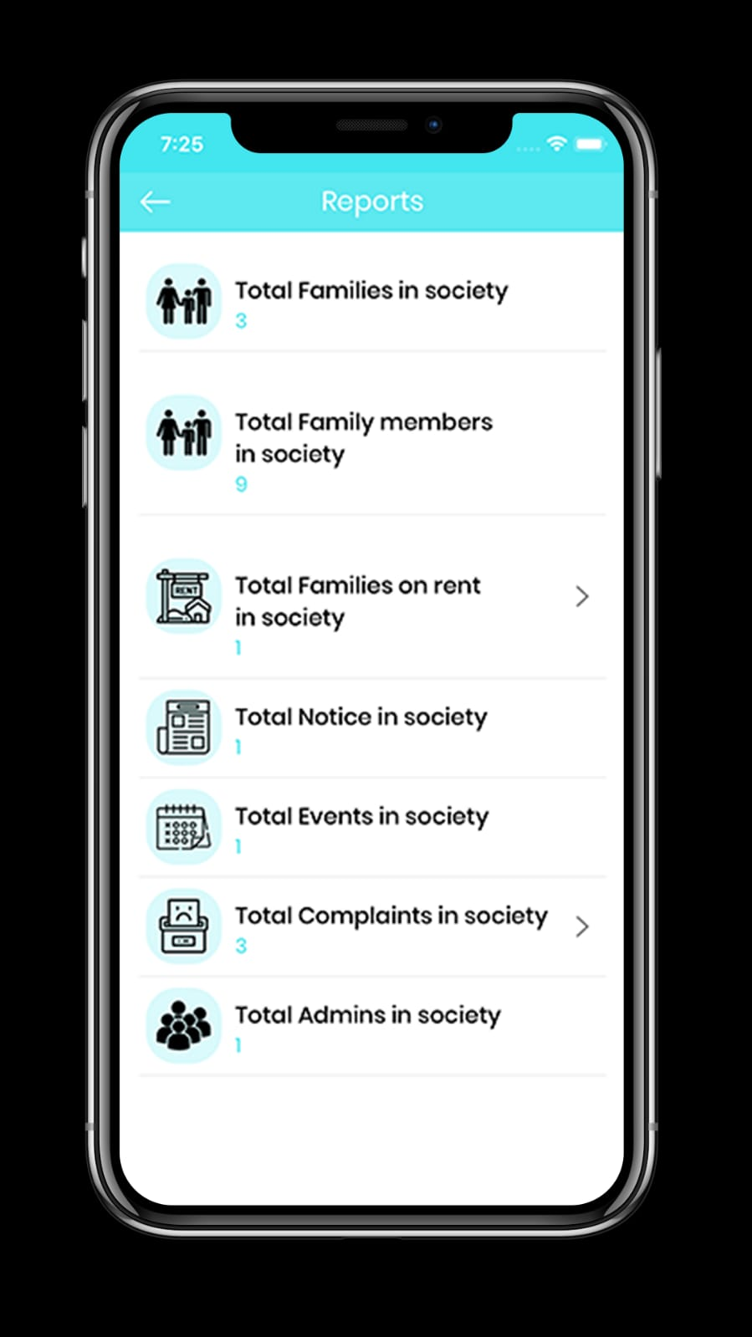
INTRODUCTION
We intend to create a platform where tenets of a society can easily communicate with their management . By using our application , residents can lodge complaints, raise their concerns in society chat room, schedule their meeting easily and provide entry access to their visitors and delivery services with support for a digital noticeboard.

Slide 5
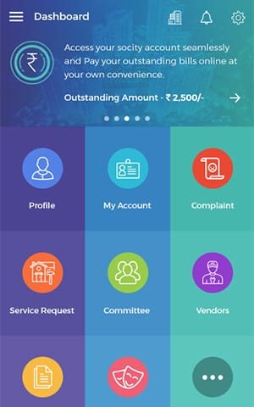
PROBLEM STATEMENT
• Visitors Entry Management –In this module, we will provide our user the ability to accept or deny the permit of there visitors.
• Complaint Centre -In this module, we allow our tenants to lodge a complaint any organizational/structural issue they have.
• Payment services: - Users can pay their Rent, management or utilities bills from payment gateway integrated application.
• Digital Noticeboard: - Users can also receive society notices and announcements from our app, a notification will be initiated to every resident whenever a new document is published.
• Meeting organizer: -In this section of our app, Users can arrange a associations meeting or discuss the details for any events etc.
• Emergency nos.: -We also display all the nearby emergency contact information (such as Police, Hospitals, Security head etc) in our app.

Slide 6

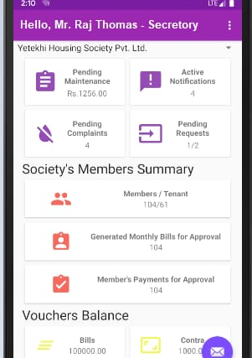
SOFTWARE/ TECHNOLOGY USED
Framework – Flutter
Programming language - Dart
Backend service – Firebase
Data Storage (Cloud Firestore)
Authentication (Firebase Auth)
Push Notification (Cloud Messaging)
Firebase Analytics

Slide 7
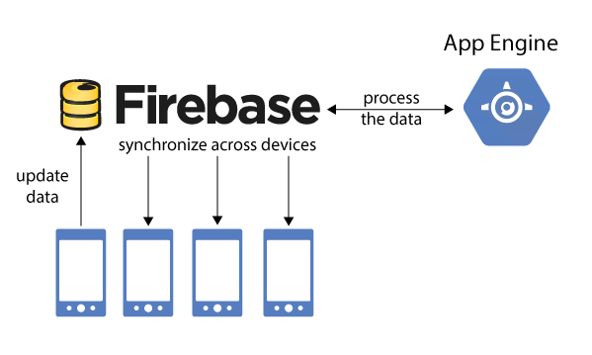
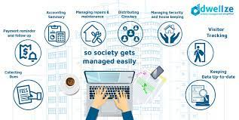
1)Coding pattern: Bloc architecture (Cubit) 2)Image storage: ImageKit 3)Video storage: Cloudinary 4)UI Prototyping: Figma 5) Target Platforms: iOS & Android

Slide 8
Major Modules and their Functionality
Visitors Entry Management –
In this module, we will provide our user the ability to accept or deny the permit of there visitors. Visitors will approach the society gates and then security head will ask them where they are going, then the security head will enter all the necessary and press the “ask for permit” button on our app, which will initiate a notification to the tenets phone asking for them to allow or deny the request. Once user presses the allow button, it will information the security to allow them to visit the owner and goes for any deliveries or orders.
Complaint Centre -
In this module, we allow our tenants to lodge a complaint any organizational/structural issue they have. Users just have to go under complaints section and proceed to fill out the details for the issue, they can also upload images if they want to and then a ticket will be generated for that particular issue. Our application will then ship out that complaint to the respective organization responsible for that issue and keep track of it too.
Services Management -
In this module, we register every house help personnel (Driver, Cook, Maid, Milkman, Laundry etc.) in our app database with a unique id no. and ask them for the house in which they desire to work for, then a notification will be sent to the tenant of the particular house asking for their permit. Tenants can also leave reviews which can also be viewed by the other residents, Tenants can also hire them from our app.

Slide 9
Payment services: -
Users can pay their Rent, management or utilities bills from payment gateway integrated application. They can also check their bill summary and daily-usage*.
Digital Noticeboard: -
Users can also receive society notices and announcements from our app, a notification will be initiated to every resident whenever a new document is published.
Meeting organiser: -
In this section of our app, Users can arrange a associations meeting or discuss the details for any events etc.
Emergency nos.: -
We also display all the nearby emergency contact information (such as Police, Hospitals, Security head etc) in our app.

Slide 10
Functional Requirements:
FIREBASE
We are using a cloud based back-end solution by Google which we handle our authentication (including email verification, mobile number verification), cloud data storage (document-based NoSQL database known as cloud Firestore), cloud messaging (used for push notification service) and Firebase analytic (for analysing and recording the end-user experience).
ImageKit.io and Cloudinary
We are using ImageKit and Cloudinary as our CDN (Content-delivery network), all the media uploads and downloads for this application will be handled by this platform. It also offers live image transformations.
Flutter Framework
Flutter is Google's SDK for crafting beautiful, fast user experiences for mobile, web, and desktop from a single codebase. Flutter works with existing code, is used by developers and organizations around the world, and is free and open source.
BLoC pattern
Its a state management system for Flutter recommended by Google developers. It helps in managing state and make access to data from a central place in our project.

Slide 11
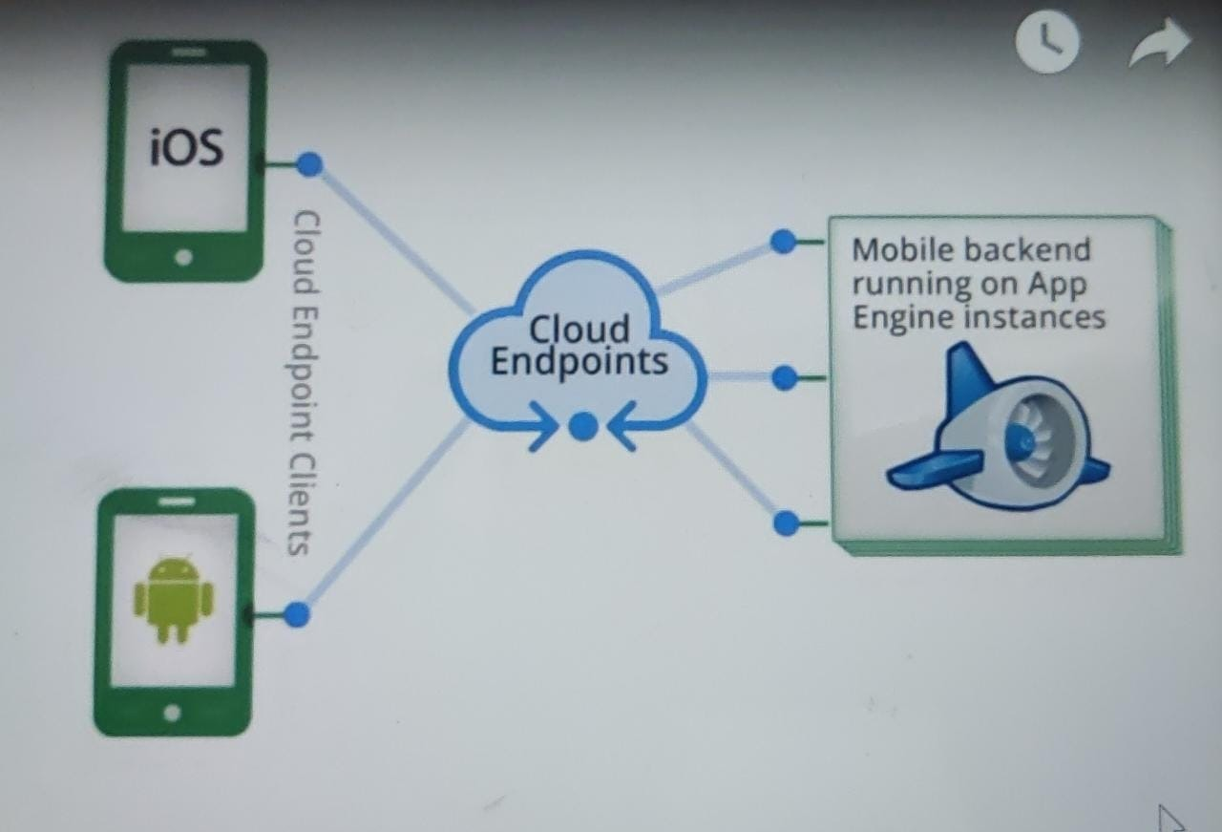
Non-Functional Requirements
Transitions Package
UI Widgets
Fonts Package
Animations Package

Slide 12
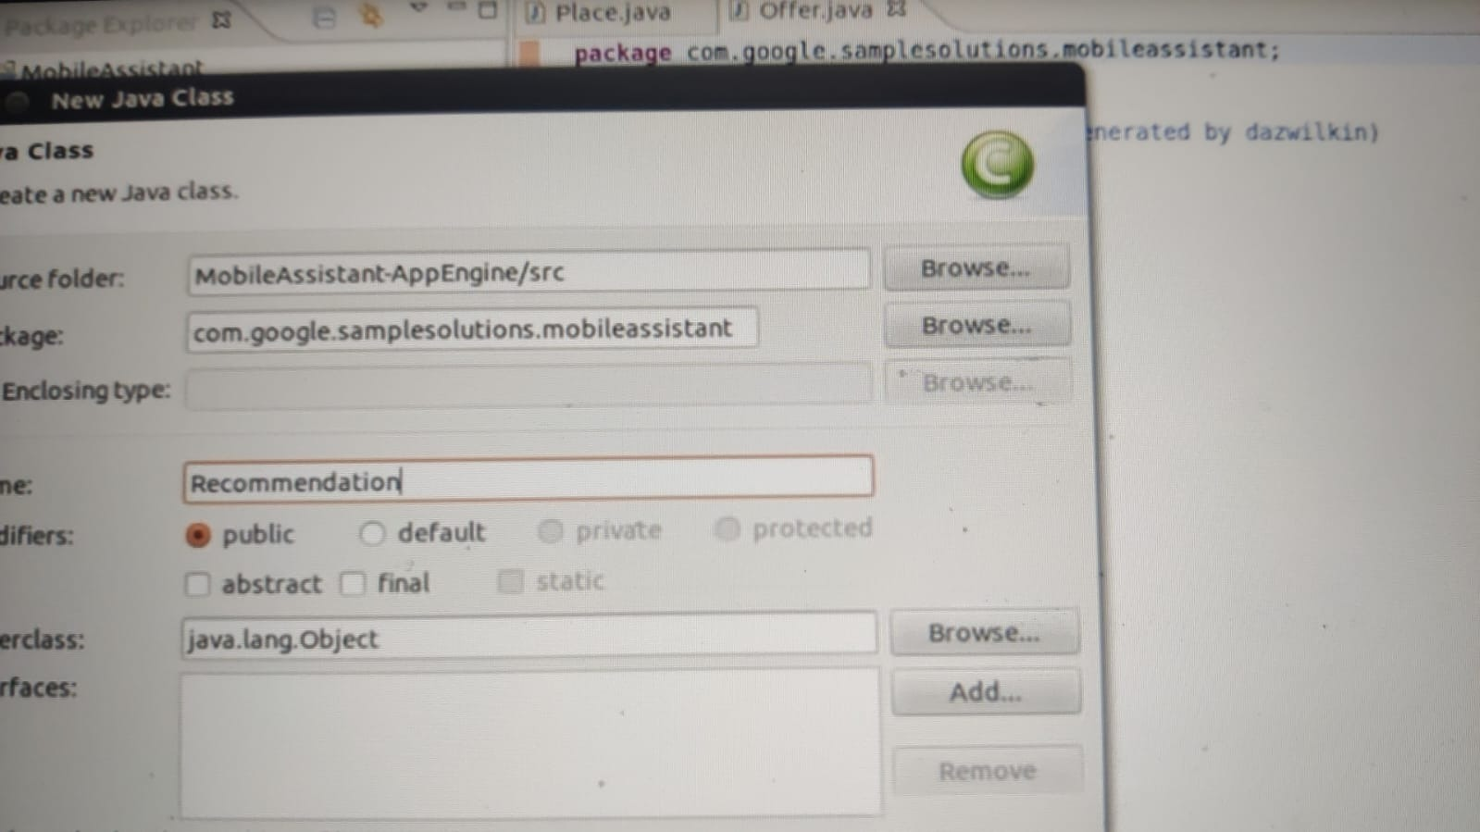
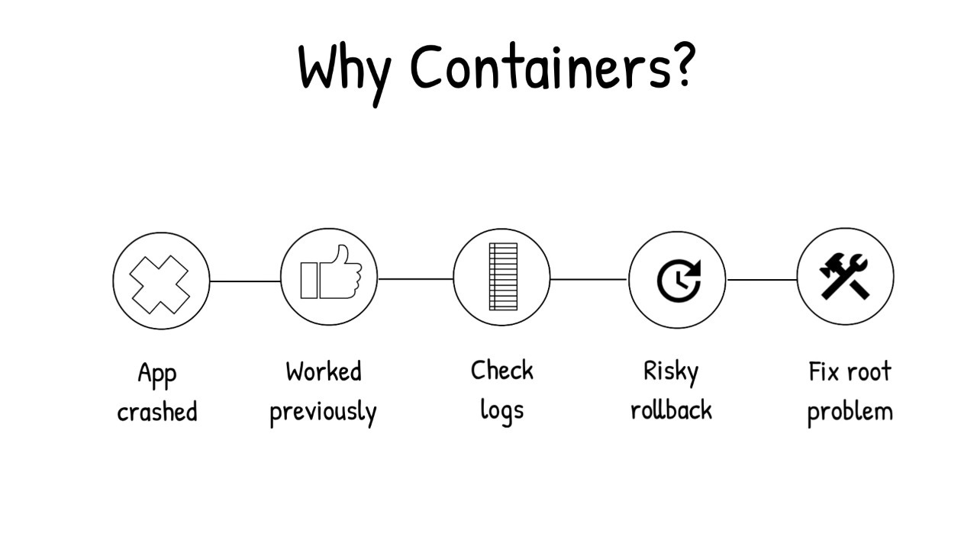
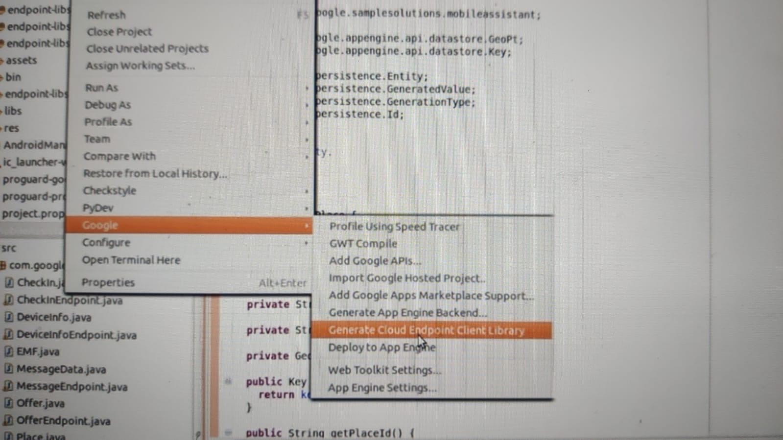
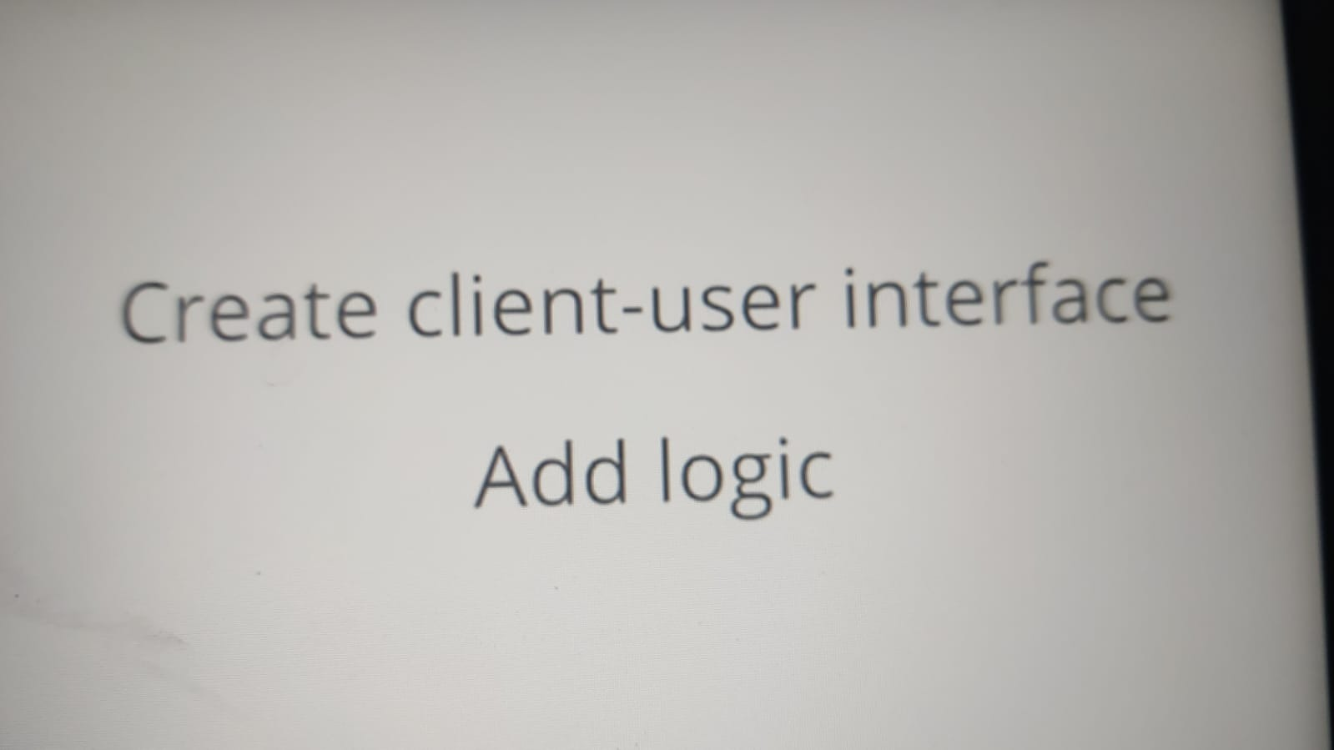

Slide 13
THANK YOU

